Slide 1



Designing Your CX Education Program: A Tools, Tips and Tricks Masterclass
Why and how learning and development pros design customer-centric learning programs, and some of the tools they use.
An McorpCX Lessons Learned Webinar

Slide 2
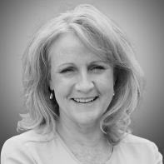


Your hosts for today:
Diane Magers, CCXP
Advisory Director at McorpCX and Emeritus Chair of the CXPA
Suzi Earhart, CCXP
Practice Leader,
Program and Change Management
Michael Hinshaw
Founder and President,
McorpCX
  Accomplished Experience Management, Sales, and Transformation Executive
  Has led and advised on experience disciplines for major brands across the globe for over 25 years
  Previously CEO for the CXPA (Customer Experience Professionals Association)
  Professor of Practice, MS-CXM program at MSU & Journey Management at SMU
  Expert contact center, IT, and operations business executive.
  Led 6 customer experience transformations for 5 firms, driving NPS up, and service costs down
  VP of CX for two companies
  CCXP, Certified Customer Experience Professional
  Prosci® certified Organizational Change Management Practitioner
  CX industry pioneer and thought leader on over a dozen “Global CX Thought Leaders to Watch" lists
  Founder of $300M business built on customer experience principles
  Best-selling author: Smart Customers, Stupid Companies:
  Why Only Intelligent Companies Will Thrive, and How To Be One of Them
  Mentor and Richard H. Holton Teaching Fellow at U.C. Berkeley’s Haas Business School

Slide 3
Today we’re going to… Discuss creation of a ‘compelling why’ for CX education; Review key steps to take to get a program started; See how to engage learners to maximize learning impact; Last, share some tools and a Q&A…

Slide 4
Three (of many) reasons to focus on customer-centricity:
90% of executives
60% more profitable
75% of executives
Say they want to compete on customer experience¹… [and being customer-centric is how you get there].
Customer-centric companies are 60% more profitable than those that aren’t.²
Say customer experience is important, and their CX teams say that these execs act accordingly.³
1) Gartner Group 2) Deloitte 3) Forrester Research

Slide 5
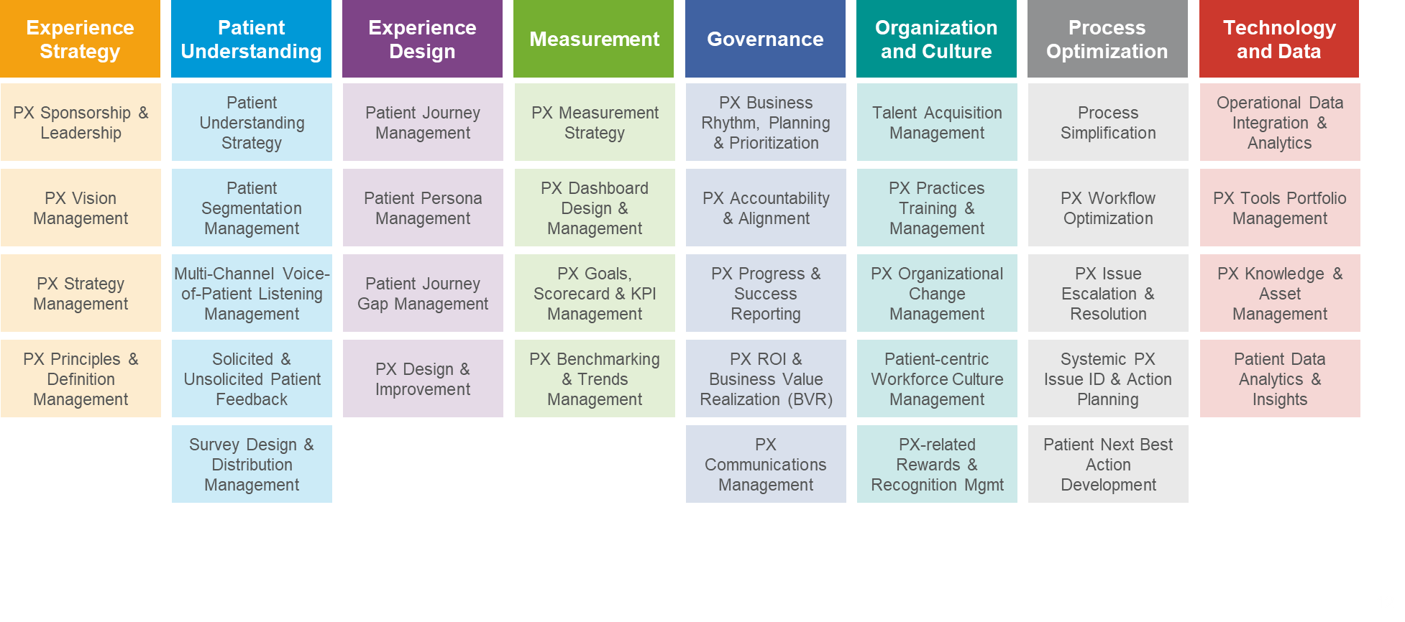
The “Worlds’ Most-Admired Companies” are doubling down on building customer-centric capabilities and culture….
“WMAC” leaders cite culture as the #1 most underrated (crucial) determinate of future success¹
87% of these leaders committed to culture (even in a downturn)
[This is a capabilities model we built with a life sciences client]
1) Korn Ferry / Org Transformation and the World’s Most Admired Companies

Slide 6
At the same time, they’re embracing Learning, Customer Focus, and Collaboration as their top culture priorities.
Top 3 Culture Priorities¹
Because… Business Value!
Customer
Centricity
Customer Acquisition and Retention
Learning
Customer Focus
Collaboration
Customer Value and Share of Spend
Business
Results
Loyalty
Experience-Driven Growth and Profitability
Employee
Engagement
Innovation
Employee Productivity
Talent Acquisition and Retention
1) Korn Ferry / Org Transformation and the World’s Most Admired Companies
Notes:
Source: https://www.kornferry.com/insights/featured-topics/organizational-transformation/how-the-worlds-most-admired-are-shaping-culture?

Slide 7

Guiding employees more effectively through their career journey with you, boosting engagement, productivity, and retention
My Career Journey, and Some Moments That Matter Along the Way…
I Apply
I Apply
I Apply
I Leave
I Leave
I Get Hired
I Leave
I Get Hired
I Get Hired
I Join
I Join
I Join
I Grow
I Grow
I Progress
I Grow
I Progress
I Progress
Learn about the company and job
Explore an opportunity
Get an offer
Join company
Meet new people
Understand role
Get feedback
and coaching
Develop skills
and work
experiences
Get recognized
Make transitions in roles, functions, responsibilities
Maintain, grow relationships
Balance work-life
Voluntary
Involuntary
Retirement
Life event
Referral

Slide 8
Three (more) reasons to focus on educating your people:
47% Less likely to leave
218%
more income
94% of employees
Employees who spend more time learning are 47% less likely to leave their company.¹
Per employee than companies without formalized training programs.²
Stay longer at organizations that invest in their career development.¹
1) LinkedIn Workplace Learning Report 2) Association for Talent Development (ATD) Research

Slide 9

In spite of all this evidence, it can be hard to get customer experience education and training prioritized.
“The value isn’t clear to me…
“The value is
clear, but it isn’t compelling…
“It isn’t tied to my goals or ‘care abouts’…
“The cost of inaction isn’t high enough to drive action…
“It’s going to take too long, and we need results now…
“Budgets are tight and I have other priorities…

Slide 10
You make it happen with a business case that leverages these two guidelines to set the stage for, build, and communicate it…
Make a compelling case for the decision makers (people!) you need to buy-in
Link proposed education to business value in ways that resonate

Slide 11
Start with a story that compels support by aligning it with stakeholder motivations, goals, and care abouts…
Your Hero
The Hero’s Journey
Impact
Minimal
Value
Shortcut
Customer/Employee Success
Situation
Significant Value
Pain
Beginning
Middle
End
Notes:
Storytelling is a skill / an art
Yes you can be trained and mentored (internal and external)
Practice makes perfect
Like a great book start with where you want to go
Framing it from the eyes of the customer is a powerful motivator
Especially with real customer feedback
Why can the org not afford to NOT do this
Are there pressure valves – areas where the org can assess how things are going and/or back away or increase focus

Slide 12
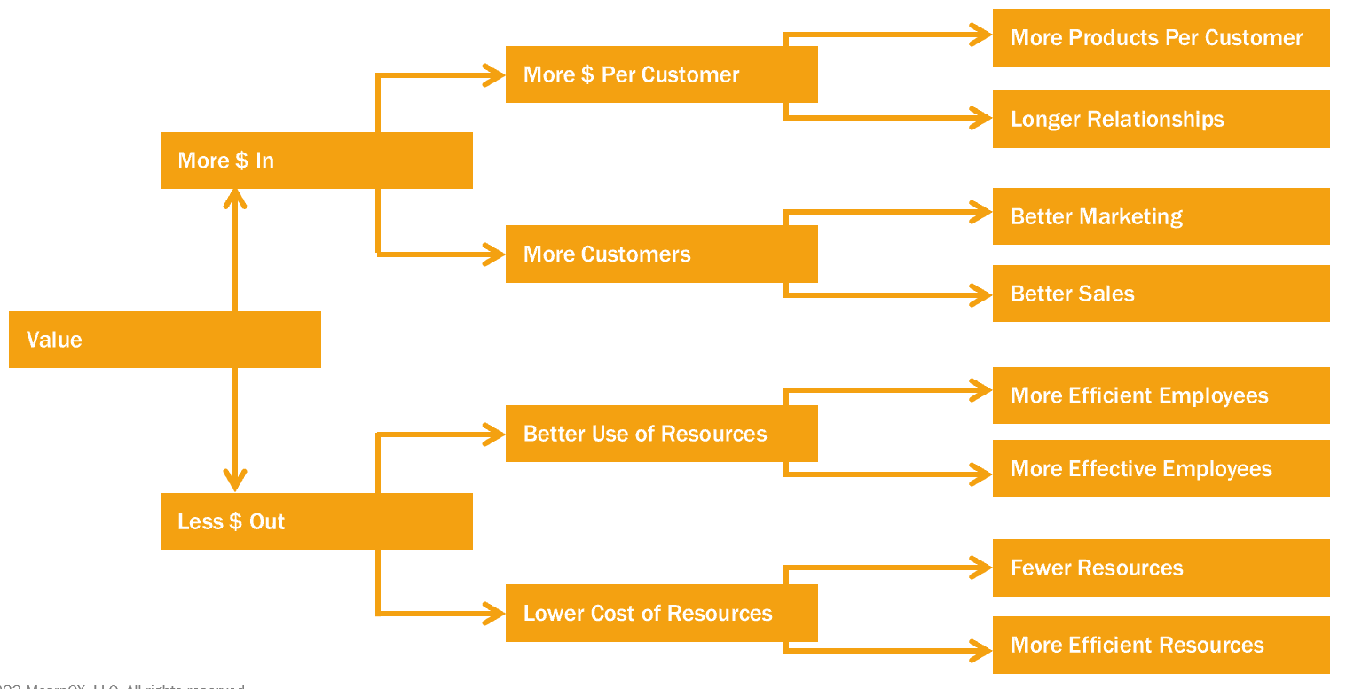

Then talk about how you’ll link these investments to business value, which simply put links to more $ in, or less $ out…
Notes:
Mostly the cx function is a consultant and advisor to a bus dept that owns the business case
Your numbers need to be solid
Aligned with todays careabouts (they change .. Growth, cost reduction etc.)
And may or may not be focused on cx metrics .. Involve yes .. Focus on [prob not
But cx and ops and financial Measures need to be declared that can be tracked
Be clear about what you know and what you don’t
And when you point to a departments numbers you need their support
And the right level of precision

Slide 13
At the end of the day, these come together in a business case framework and planning tool that can look something like this:
Stakeholders
Benefits of Action; Risks of Inaction
Activities and Resources (Human and Financial),
Risks
Issues and Concerns
Motivators
Strategic Alignment
ROI
Milestones
Customer Impact
Options
Employee Impact
Comparable and Competitive Examples
Related Initiatives & Dependencies
Business Impact
Notes:
CX maturity of your org – rarely is cx actually top of mind (unless you are amazon!)
How cx mature are your stakeholders – true believer, interested, ridealongs, antagonists !
Different stakeholders have different careabouts
Strategy driven, tech driven, financially driven, competitively driven (external company or internal stakeholder)
Just like CX itself you are unlikely to succeed by talking in your voice .. You need to personalize to the stakeholders
The art of fingerprinting – give people something to change / correct and they are vested
Risk is a big issue – how solid are your schedules, dependencies, allowance for external factors etc
Hook to other key imperatives

Slide 14
Today we’re going to… Discuss creation of a ‘compelling why’ for CX education; Review key steps to take, to get a program started; See how to engage learners to maximize learning impact; Last, share some tools and a Q&A…

Slide 15

Start by identifying compelling needs and opportunities;
Look closely into both business and employee needs
  Interviews with HR, including Recruiting
  Employee Engagement Survey Results
  Course feedback to identify gaps post-learning
  Career paths (current and projected)
  Development program gaps
  Exit Interview findings
Uncover Employee Needs
Identify Business Goals and Gaps
  Interview Stakeholders: ‘What keeps them up at night?’
  [Sales, Marketing, Service, Operations, Finance…]
  Review Business strategy, goals and outcomes:
  How does this contribute?
  [e.g., talent retention, customer focus, innovation]
  Analyze scorecards against key metrics
  Feedback review sessions from your VOC data

Slide 16
Ideas for example opportunity cases: Looking for “just right” charter projects to get you started with a CX education program
New Product Launch
Voice of Customer Introduction or Expansion
Service Issues
Customer Attrition
Cross-functional teams
Innovation orientation
Design thinking
Journey Insights
Pilot Group/Prototyping
Persona Understanding
Journey Insights
Empathy Skills
Conflict Resolution Expert
Expectation Setting
Cross-functional team
Customer Listening
Process orientation
Customer feedback and Insights Analysis
Segment/Persona focus
Expectation Gap Management
Survey Design
Customer Measurement Strategy

Slide 17
Assess your Organizational CX Learning Readiness and adapt your design accordingly; We suggest four key areas….
Culture
Knowledge
Skills
Application
Customer Experience Training and Education: Readiness Assessment
On a scale of 1-5, with 1 being “never” or “not at all” and 5 being “always” or “a great deal”, to what degree…
1. Do your people currently prioritize customer centricity in decision making?
2. Are all employees, from the C-suite to the frontline, involved in the
customer experience process?
3. Do your employees understand customer behaviors, needs,
and expectations?
4. Are employees trained on both the technical and emotional aspects
of customer interactions?
5. Does your organization's training program equip employees with
tools to understand and interpret customer behavior?
6. Do you utilize design thinking, empathy training, and customer
journey analysis in your training programs?
7. Are employees encouraged to use creative thinking and problem
solving in their interaction with customers?
8. Do employees feel empowered to make decisions that benefit
the customer?
9. Does your company culture encourage a sense of ownership
among employees for quick issue resolution?
10. Is innovation and agility, focused on improving customer experience,
part of your company culture?
[20 Questions: Tool to be provided post-webinar]

Slide 18




Create your CX Learner persona, linking to their goals and needs
Persona | Role | Depts | Job Priorities | Experience Goals | Education Need / CX Skills
 | Direct Interacts with customers directly | Sales Customer Serv. Operations … | Pro-active Conflict Resolution Problem Solving Productivity | Outside-In thinking Understanding customer needs and journeys Using CX Skills in simple and complex interactions | Why CX, What’s In it for Me Conflict Management Expectation Setting Empathy
 | Indirect Designs and influences customer interactions | Product Mgmt. Marketing Info Tech. … | Optimizing processes​ Implementing efficiency ​ Tracking results | Understanding customer journeys Innovating Design Analyzing results for potential and actual impact | Value of CX Design Thinking, Storyboards Measurement Strategy ROI Analysis
 | Low Contact Supports the people and systems with which customers interact | Legal HR Finance … | Mitigate risk Align objectives with employee and organization health and wellness | Outside-In thinking Innovating Design Analyzing results for potential and actual impact Talent Acquisition | Why CX, What’s In it for Me Survey Design Dashboard Design, Mgmt. Innovation Tools Management
 | Leadership Modeling behavior through everyday actions, language and attitudes​ | Executive Team Managers Team Leads | Business results attainment Employee performance Employee retention | Support Learning and CX Culture Change Talent Development Resolve and Role Model handling of Complex customer requests | Why CX, What’s In it for Us Critical Thinking Empathy, Expectation Setting Escalation Management Process Orientation

Slide 19

Reference these seven critical customer-centric education competencies in determining learning and education priorities
1. The “Why”
2. Behaviors
7. Application
3. Insights-to-Action
6. Design
4. Value of CX
5. Capabilities

Slide 20
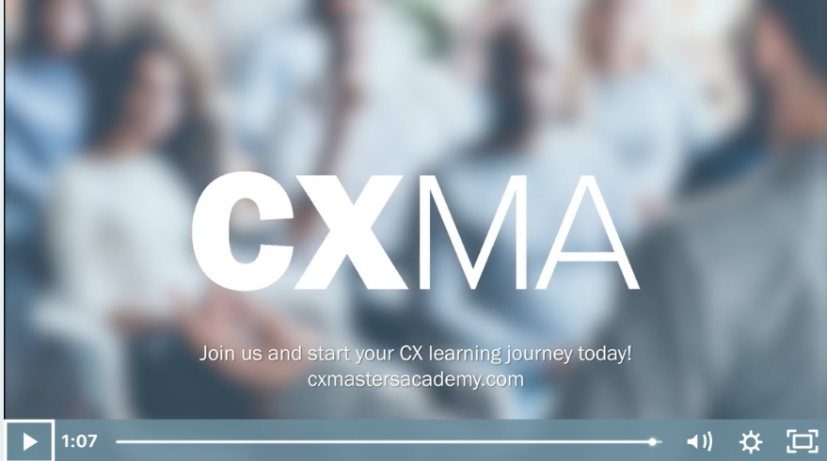
Ascertain the level of knowledge needed by your learners to think and behave in new ways of thinking and working
Level 4: Subject Matter Expert
Supported with:
Coaching Tips:
Success factors
Best Practices
Development Standards:
Activities (Courses, Mentoring, Experiences)
Timing
Right-Size Approach, e.g. CXMA eLearning:
Level 3: Extensive Experience
Level 2: Working Experience
Level 1:
Basic Understanding

Slide 21
Example: Building a role-based CX Competency model…
Customer Care Rep [Example]: CX/XM competencies Model – Skills, tasks, knowledge, tools, attitudes.
Level 1 Basic Understanding | Level 2: Working Experience | Level 3: Extensive Experience | Level 4: Subject Matter Expert
Cites the cost and benefits of good customer experience | Communicates the importance of customer needs/expectations and commits to resolving them. | Advises other on creating customer centric or experience led environments or interactions. | Champions, models and directs a commitment to externally focused decision-making tied to customer business needs and satisfaction.
Can define CX and what the organization is trying to accomplish | Helps link organizational objectives to customer needs and expectations. | Anticipates customer needs, focusing efforts to proactively meet needs and exceed customer expectations. | Consults with leaders regarding critical success factors and details to being a customer focused organization.
Explains why customer satisfaction is important to successful product/service delivery. | Meets/visits regularly with customers to understand their wants, needs and expectations. | Communicates and models the criticality of customer focus as an organizational strategy. | Develops “best practices” to create, evaluate and enhance customer loyalty that are sought by others within and outside the organization.
Focuses activities on developing and maintaining positive customer relationships. | Solicits customer feedback and acts on improvement opportunities. | Facilitates creation of the “right” products and service to resolve customer business issues. | Helps the organization anticipate customer needs and experiences, and then guides to address proactively through design and soft skills.
Coaching Tips:
• Communicate to customers you are open to constructive criticism and willing to work on issues they view as important.
• Design your customer interactions considering the customer’s viewpoint and manage and design interactions and experiences from their viewpoint by understanding the needs, expectations, and desired goals that will create the most value for the customer and the brand
• Gain perspective from the customer’s viewpoint by reviewing Voice of Customer or other sources of information about their experience.
• Select role models of strengths or weakness in customer-centric behaviors. Learn the characteristics and thought processes they use to create great experiences.
Development Statements:
• Take a course during 1st quarter to learn how to provide more visible response to customer feedback.
• Work with an experienced customer focused associate on a project next year. Analyze what they do/don’t do and imitate their successful behavior and word usage.
• Take a course on how to develop insights and action plans derived from customer’s feedback.

Slide 22
Distill this data, and integrate it into your Learning Program Charter; these are the critical questions you need to answer…
Who are we trying to impact?
What are they doing today?
Who (both customer and employee segments) are we trying to affect?
What groups are they in?
What goals, needs, and wants do they have?
What motivations do they have to change?
What mindset and behaviors do we want them to exhibit tomorrow?
What are the tasks people are performing today?
What are their success criteria?
What knowledge and skill sets do they have?
How well are they doing?
What do they need to be successful?
How will those mindset and behavior
changes affect results?
What do we want people to do differently?
What is their new need and/or goal?
What is the Brand need and/or goal?
What skills should they have?
How will we track / see they are behaving and feeing differently?
What employee skill
gaps will we close?
Culture?
(Less attrition, More qualified applicants, More career growth)
Increased Revenue?
(Increased $ per Customer, More customers)
Lower Costs?
(To serve, To hire)
Talent to Impact?
(Innovation, Creativity)
What do we need?
What other training or education is planned?
How will we target the gaps for each target audience and individual?
How do we engage them to define and design what they need?

Slide 23
We’ve been talking more about what the org needs… but you must also focus on what your people need
Understand what employees want, need, and value – and
the impact on their contributions & actions
Design programs that engage learners by addressing their needs and wants

Slide 24
Today we’re going to… Discuss creation of a ‘compelling why’ for CX education; Review key steps to take, to get a program started; See how to engage learners to maximize learning impact; Last, share some tools and a Q&A…

Slide 25

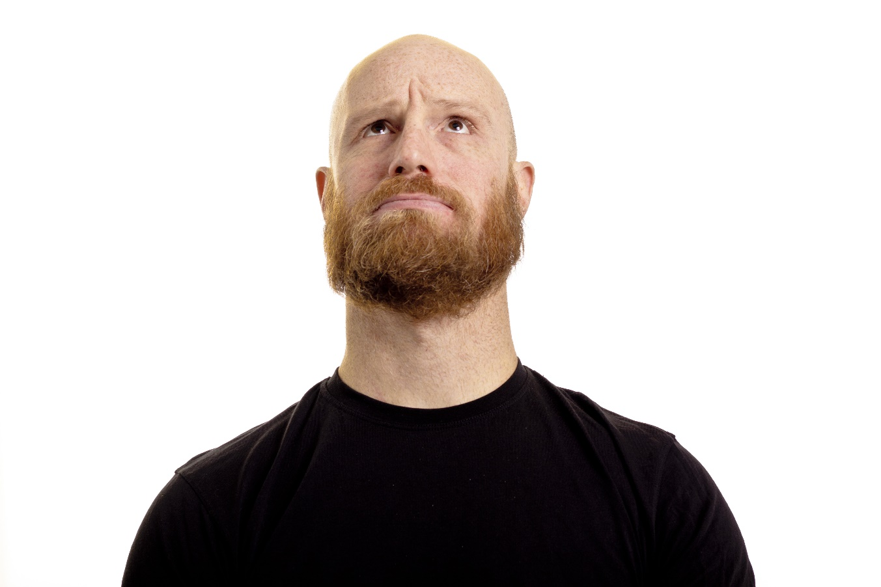
Connecting what you want, with what they need...
    “I'm excited this company is known as a great employer, but I wonder what that means? Will my contributions be valued? will they give me the skills I need to be effective? Lots of change happening!
    “My leader never told me why things needed to change. The top-down approach was too broad for me to translate into what I do every day. I feel angry, unprepared, and apprehensive about my job.”

Slide 26

Reflecting needs and values: Everyone wants, expects, and deserves, engagement and connection.
Engaged
Want to be involved, consulted, provide ideas
Personal
Want 1:1 experiences and support, personal growth
Valued
Empowered, recognized, rewarded
Purpose
Make a difference, give
back, contribute

Slide 27
Exercise: Define ‘victory’ for your education program
Defining goals: Victory Circle
  What:
  Envision future actions, thinking, ways of working
  Why:
  Define the targets, outcomes and impact
  How:
“The Victory Circle”
What Success Looks Like
Doing
What are
people doing differently?
Feeling
How are
employees
feeling?
The Exercise…
Imagine we have moved into and ideal future… you’re celebrating your success…
Brainstorm as many examples as you’d like of what this looks like, feels, or what the organization is doing differently
No solutions yet; Just the end state
How does that feel? What does it look like?
?
?
Notes:
Future story – how did we contribute

Slide 28




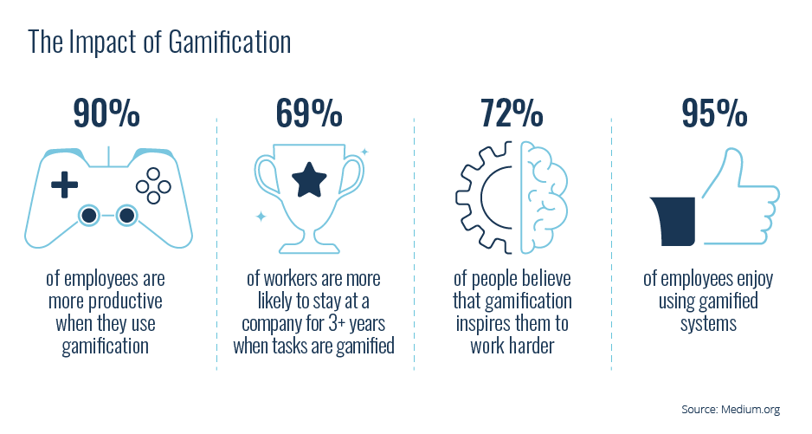
Needs-based assessments by role/level helps define the what...
Skills:
Algorithms and data models
Data wrangling and database management
Machine learning and deep learning
Statistics and probability
Data visualization
Programming
Needs:
Connect with Stakeholders
Expand use of insights
Innovate
Engage teams
Move people to action
Data Scientist
Story Telling, Human Centered Design, Gamification, Innovation

Slide 29

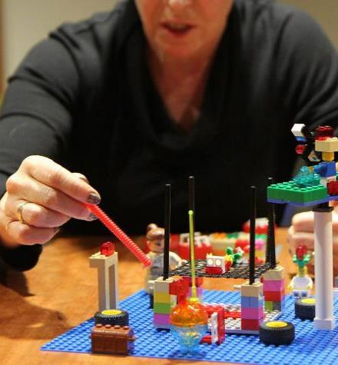
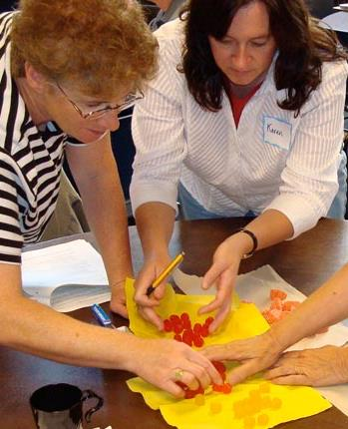
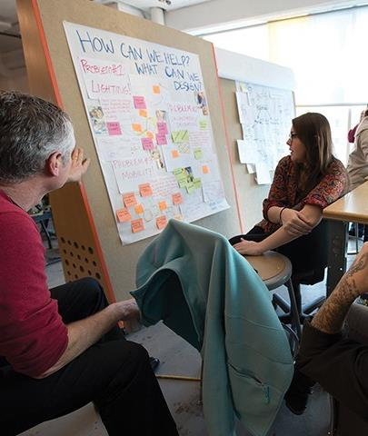
Cater to what sticks: Leveraging emotion, creativity, and growth
Experiential
90% of what’s being learned is being remembered when doing. We immerse ourselves in the experience and feel our way through it, raising emotional intelligence and self-awareness.
Playful
Adult learning is most effective in a positive emotional state - when it’s fun. It makes intimidating, perplexing material engaging and easier to comprehend.
Iterative
A cyclical process leads to twice the impact of linear learning and builds new habits and paradigms, which dictate our behavior and decision making in our daily lives.
Collaborative
As social beings, adding social and collaborative elements to learning significantly improves outcomes. Whether on or off-line, the results are always more powerful.

Slide 30
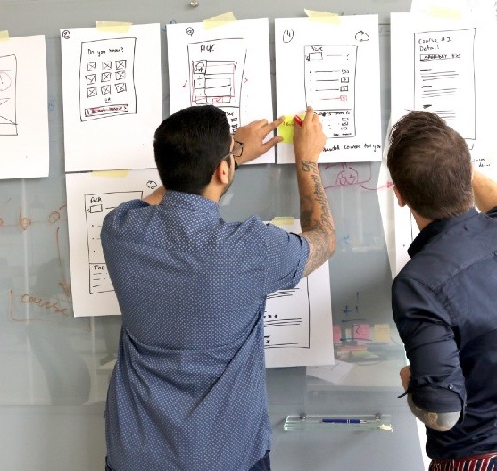
Exercise: Intentional, co-created learning design – MOO!
Defining goals: Victory Circle
  What:
  Creating a To-Be Storyboard for Engagement, Education and Enablement
  Why:
  Co-created with employees, story-driven, needs-based, innovation and creativity
  How:
“MOO!”
Moments of Opportunity
The Exercise…
Map out the concepts and steps for the ‘to-be’ story and journey representing the desired experience
Draw or sketch imagery to enhance steps in the story
Engage extended groups to describe what the future learning experience and content will be
Notes:
Future story – how did we contribute

Slide 31
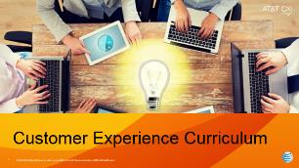
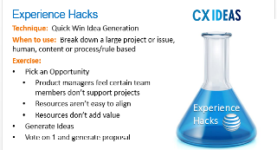
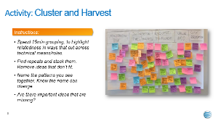
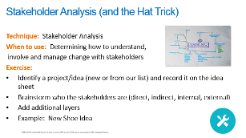
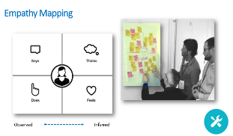
An example of how to apply powerful education…
Insights and innovation ‘Mini-Labs’ and playbooks: Fun, interactive sessions building experience design
Organization:
Expand, Engage, Collaborate
Goals for Mini-Lab Sessions:
‘Hackathon’ approach
Learn techniques
Formulate ideas for more learning
Empower and gain momentum
Build evangelists
Team building and
skill development
Teams:
Participate, Innovate, Create
Employees:
Prepare, Grow, Recognize

Slide 32




Creating a modular, multi-modal approach allows flexibility, speed, scalability, and optimally serves individual needs
Individual
Learning Needs
Head
Heart
Hands
CX Inspiration Best Practices
Defining the Value of Experiences
The Impact of Empathy
Empathy Mapping
Design Tools
Voice of Experience Audit
Type/Mode
Topic/Content
Learning Style
Role Relevant
Applicable
Human Centered Design Basics
Introduction to Voices of Experience
Emotional Conversion
Personas and Personal-ization
Template for Defining Experience Value
Experience Research Plan
Basics of
CX Strategy
Introduction to Journey Mapping
Interviewing Skills
Ethnographic Research
Experience
Design Workshops
Insight Generation Techniques

Slide 33
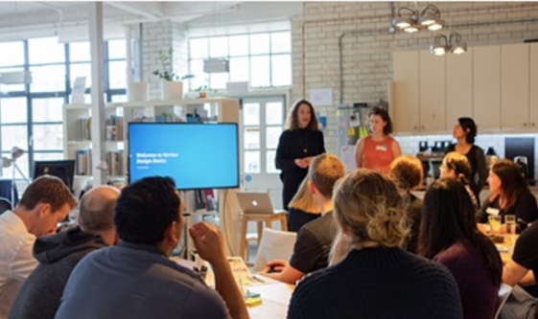
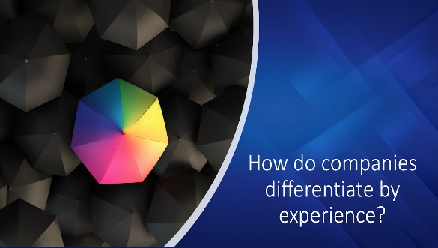
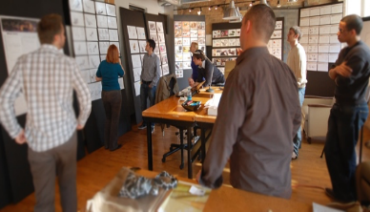
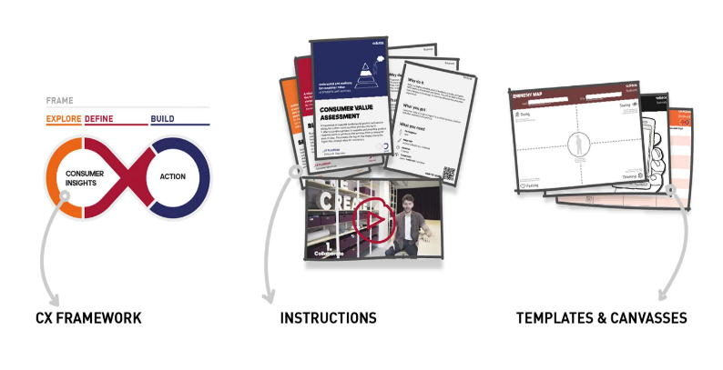
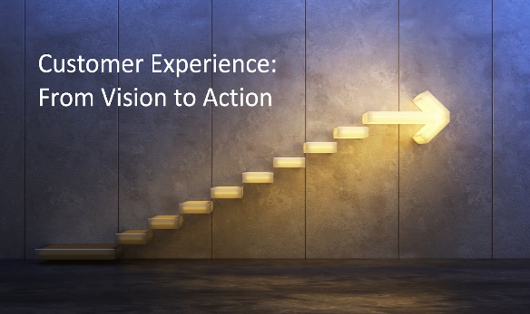

Tip: Learning Everywhere! Embedded in the rhythm of the org
Ongoing CX Events:
Community meetings, Team meetings,
Lunch and Learns
Internal Learning:
CX Learning Pathways, on-demand, certifications
Experience Design Labs:
Hands-on learning workshops,
virtual exercises
Tools, Templates, Resources:
Guide, standardize, practice
Inspiration Sessions:
Short live webinars: Learn about
best practices of other brands
Customers & Coffee:
Hearing the voice of customers/employees

Slide 34







Critical change leadership, advocates, and communications plan
Start
Best Practices
WIIFM
“What’s in it for me?” Begin with a strong opening that tells your audience what they will gain, know and apply.
Highlight personal and professional growth.
Engage
IMPACT
Appear in the right place, at the right time, in the right format suited for the intended audience.
Reinforce & Build
CLARITY
Address what they may be wondering about, based on what they’ve shared, in a concise way.
CALL TO ACTION
Add clear direction to engage with and/or implement the new resources.
Leverage advocates to build momentum.
Agile, is integrated in the day to day, and ongoing.
MULTIPLE TOUCHPOINTS
Communicate the same message across various platforms over an extended period for reinforcement.
Continual needs assessment, proactive co-creation, feedback, and impact analysis.
CONSISTENCY
Develop a regular cadence and execute a strategic calendar approach.
RELEVANCE
Present what your audience would find most helpful or meaningful.

Slide 35
Today we’re going to… Discuss creation of a ‘compelling ‘why’ for CX education; Review key steps to take, to get a program started; See how to engage learners to maximize learning impact; Share some tools and have a Q&A…

Slide 36
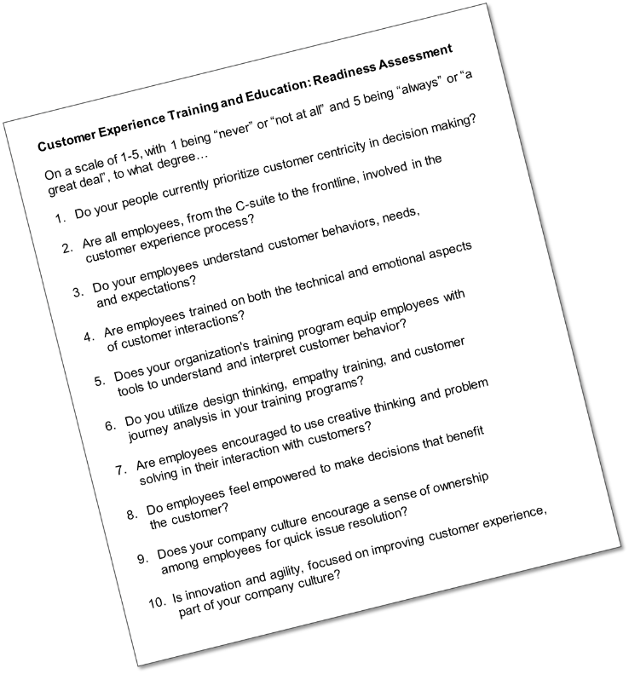
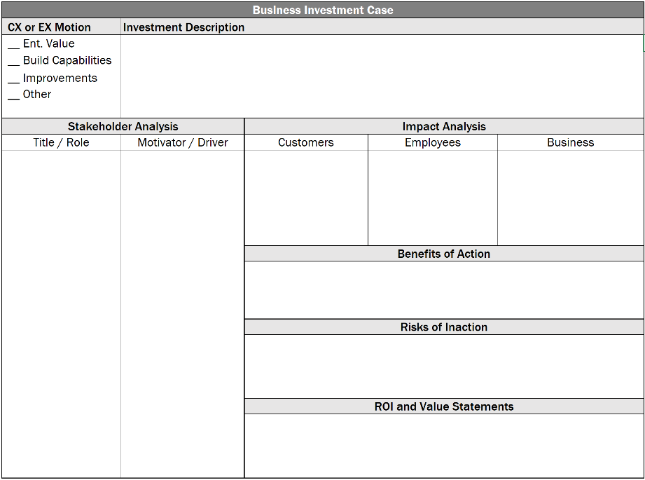
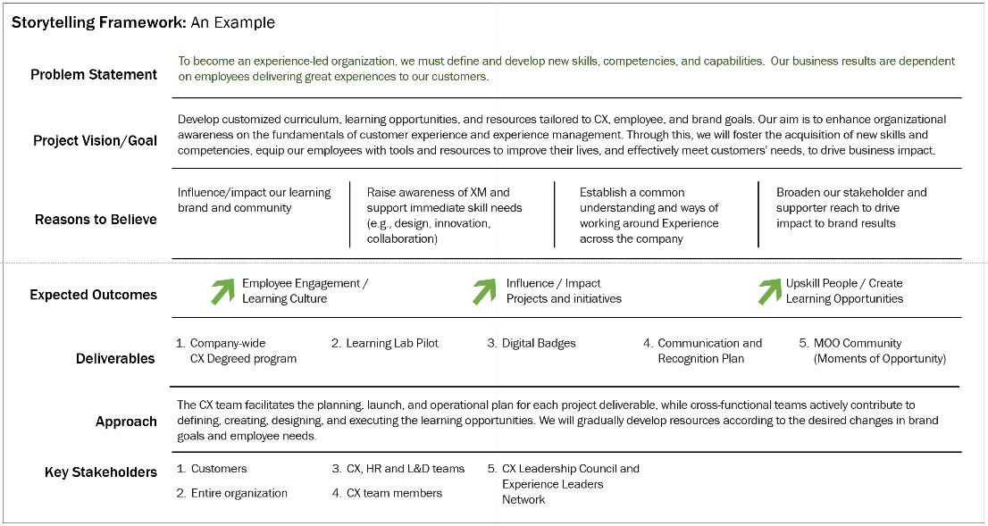
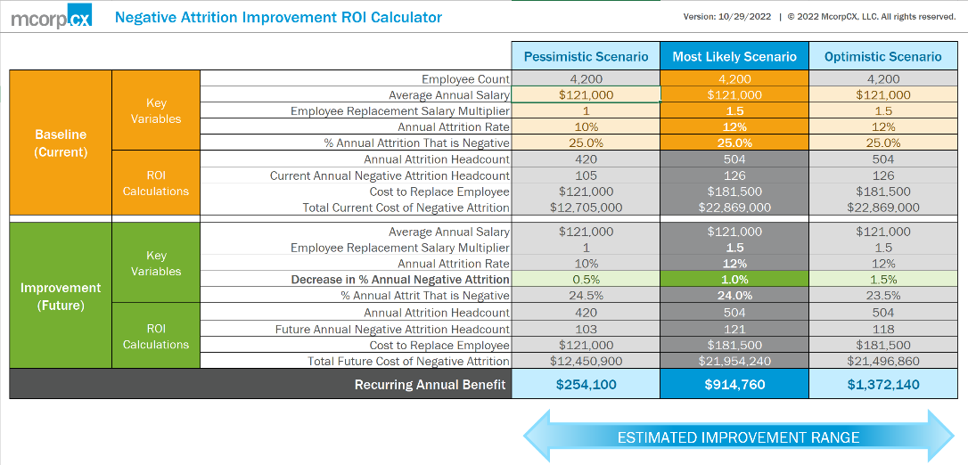
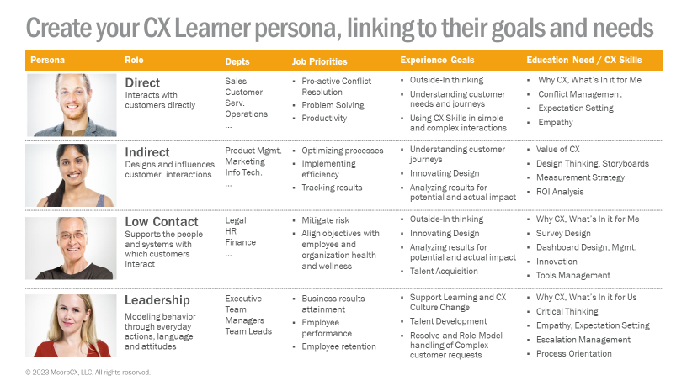
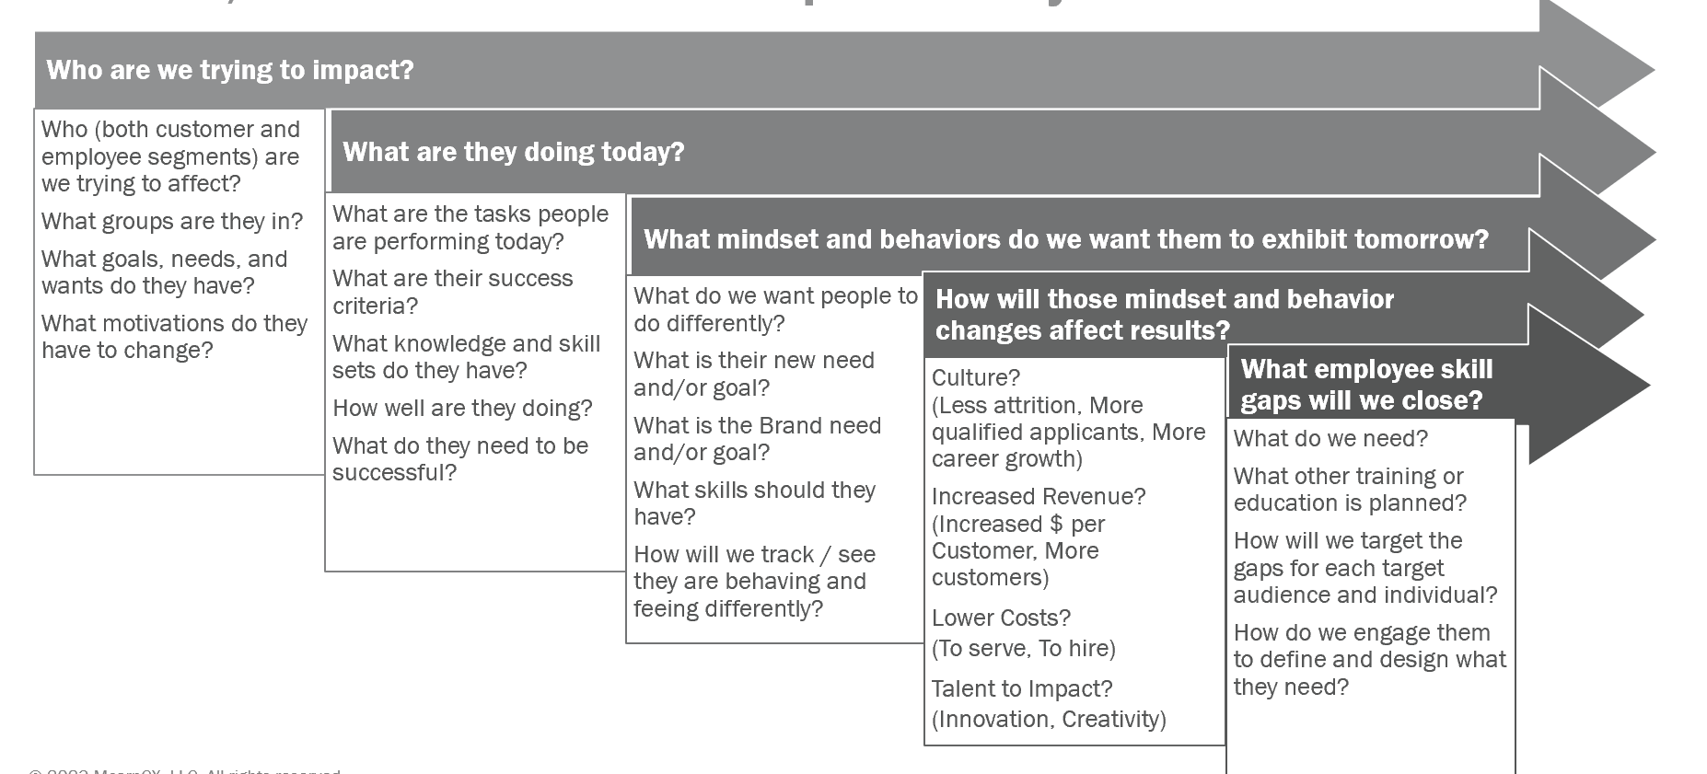
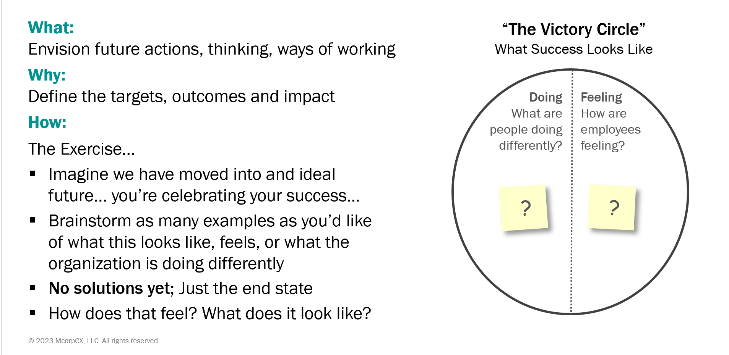
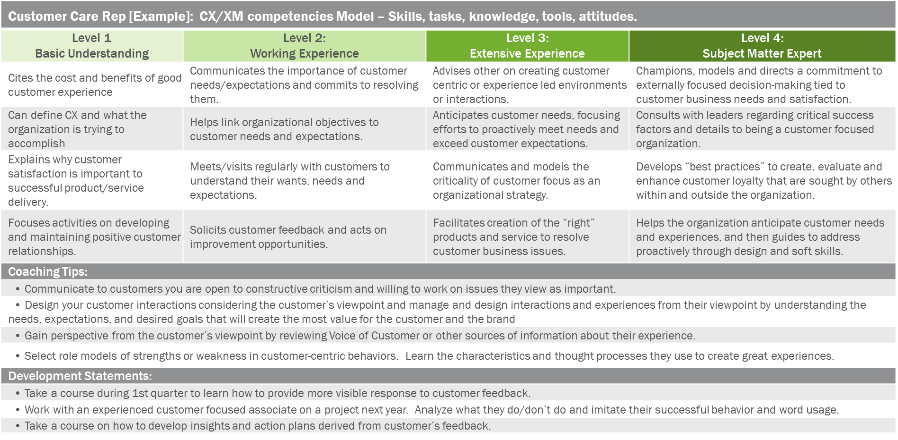
And as promised some tools you can use.
1
2
3
Investment Case Framework
Storytelling Template
CX Learning Readiness Assessment
4
Employee Actions ROI Calculator
5
Other Frameworks, Exercises, eLearning, and Models in this Presentation…

Slide 37
Some best practices to keep in mind… and let’s chat!
Purpose- and
Needs-based culture:
Learning impacts
Provide knowledge and skills to deliver great experiences
Ensure relevance for every level and role in your organization​
Different modalities for different purposes
Contextual “learning and doing” to drive behavioral change
Goals and metrics that link to program and business goals​
Change leadership,
advocates, and communication plan
Set context at the start and continue to reinforce and assess​
Notes:
Values-based culture: Learning and development
Leadership leads and engages – new leadership structure – connect to the organization – learn with them, learn about them and customers
Apply our tools of the trade:
Create a learner's journey – personalized, engaging, creates value
Functional and emotional
Experience by Design
Define the future state – behavior "think and do differently"
Traceable, trackable and measurable
Celebrate and elevate the 'naturals'
Create a learner's journey - Know who and why
Relevance and personalization
Experience applies
Celebrate and elevate the 'naturals'
Combine Human with Traceable, trackable and measurable
Behavior change
Relevance and personalization
Bite sized – Buffet
Defining clear outcomes
Fresh and Experiential
Values-based Culture
Opportunistic and structured

Slide 38
Tools, Templates, and Frameworks

Slide 39
And as promised some tools you can use…
1
2
3
Investment Case Framework
Storytelling Template
Employee Actions ROI Calculator
A framework to collect the data needed to build a business case for a Customer and/or Employee Experience initiative. This can be used for any initiative including education.
A template to document the rationale for your Experience initiative investment request. Leverage the different components of this template to create the right story for each of your stakeholders.
A multifaceted ROI tool calculates the benefits derived from changes in attrition, hiring, accelerated ramp time, and employee productivity. Use this input in the education business case.
Download Here
Download Here

Slide 40
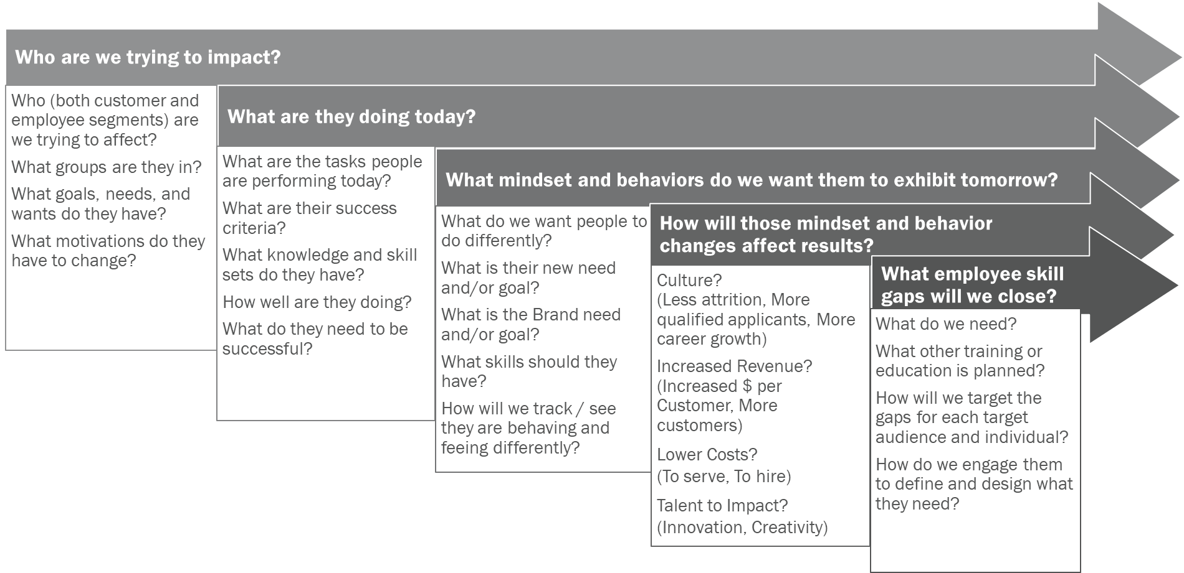
And as promised some tools you can use...
4
CX Learner Persona Template
5
Role Based CX Competency Model Template
6
Learning Program Charter Template
A simple persona template that can be used to distinguish the different roles within your organization and how their job priorities and experience goals are connected to CX education and skills.
A methodology to build the progression of education to show how a specific role will gain the knowledge and skills to increase their CX maturity within your organization.
The key questions to answer to build the charter for your learning program. The questions prompt you to outline future state and current state for your key audiences and the impact learning intends to deliver.
Download Here
Download Here
Download Here

Slide 41
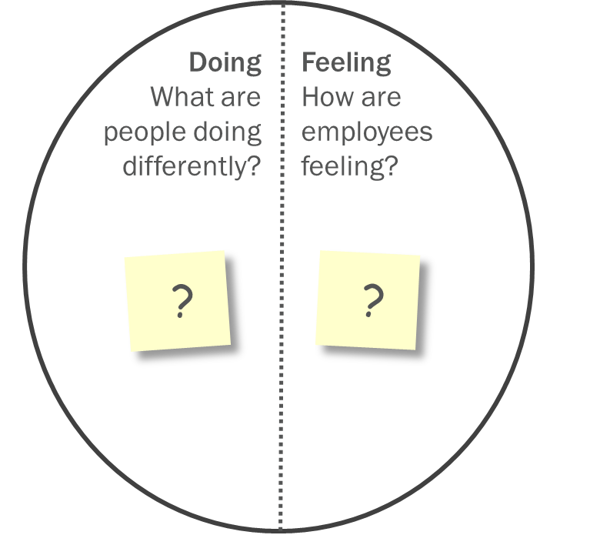
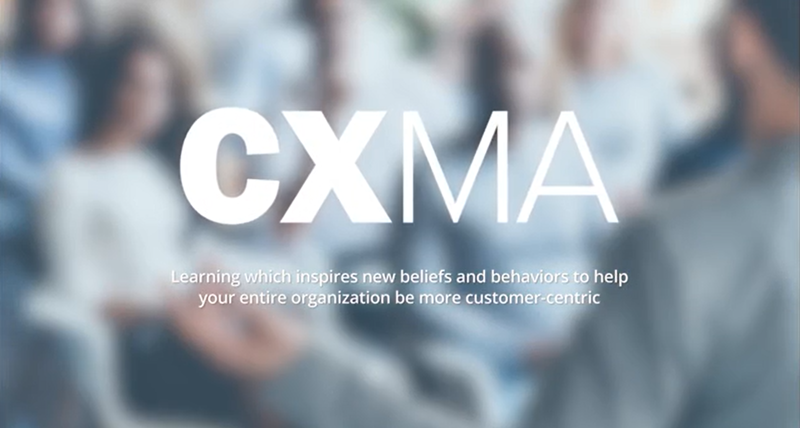
And as promised some tools you can use...
7
Victory Circle Template
8
Customer Experience Masters Academy, CXMA
A tool to define the targets, outcomes and impact of future actions, thinking, and ways of working, describing both what people will do and how they will feel in this future state.
Designed for everyone in your organization, our practical, personalized learning programs help drive greater customer centricity and customer experience excellence—making great CX easier for you, your people, and your customers.
Download Here
Link Here
Save 25% off purchase of CX101!
Use coupon code ’25OFFINTRO’
by 6/30/23

Slide 42
www.mcorpcx.com
Michael Hinshaw
D: 415-526-2651
mhinshaw@mcorp.cx
Diane Magers
D: 713-842-0567
diane@expcatalysts.com
Suzi Earhart
D: 615-478-6210
searhart@mcorp.cx

